Slide 1
fMSEA: utilizing metabolic to do metabolite set enrichment analysis
Xiaotao Shen PhD
Stanford School of Medicine
Department of Genetics
June 1st, 2020 @ Stanford
shenxt@stanford.edu
@JasperShen1990
shenxt.me
github.com/jaspershen

Slide 2

OUTLINE

Slide 3
Pipeline (metabolite annotation)
One peak matches multiple annotations
Metabolites are enriched in some pathways or modules (upregulated or downregulated).
Wrong annotations are not enriched in the head or tail of the ordered metabolites.
P1
M1
M2
M3
Pathway 1
M1
M4
M7
P2
M4
M5
M6
P3
M7
M8
M9
Pn
M1
M20
M21

Slide 4
Pipeline (metabolite annotation)
Feature
For each compound, if it has high score compound class, remove the low score compound class
Metabolite
Feature-metabolite pairs
For each peak, if it has high score annotation, remove the low score annotation
Isotope annotation
Re-score for each compound class
Group according to RT
Remove redundant annotations
Compound class
Annotation results
Score for each compound class

Slide 5
Pipeline (MSEA)
Annotation results
(ordered by fold change)
KEGG database or HMDB database (pathway or modules)
Calculate running enrichment score for each peak-metabolite pair
Permutation test to calculate p value

Slide 6
Score system

Slide 7
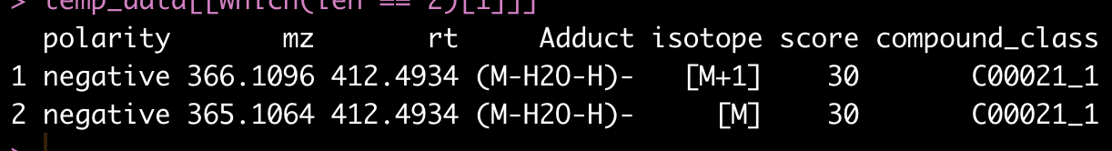
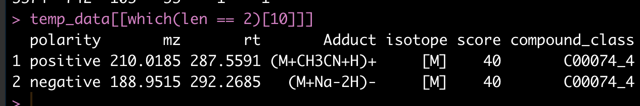
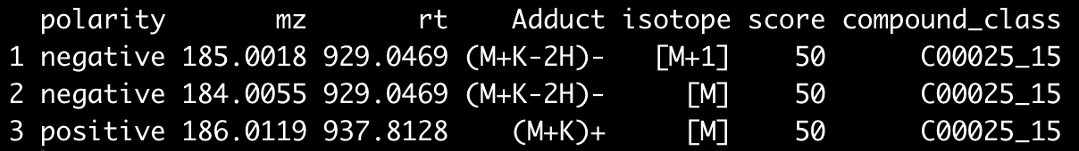
Score for compound group

Slide 8
Score distributation

Slide 9
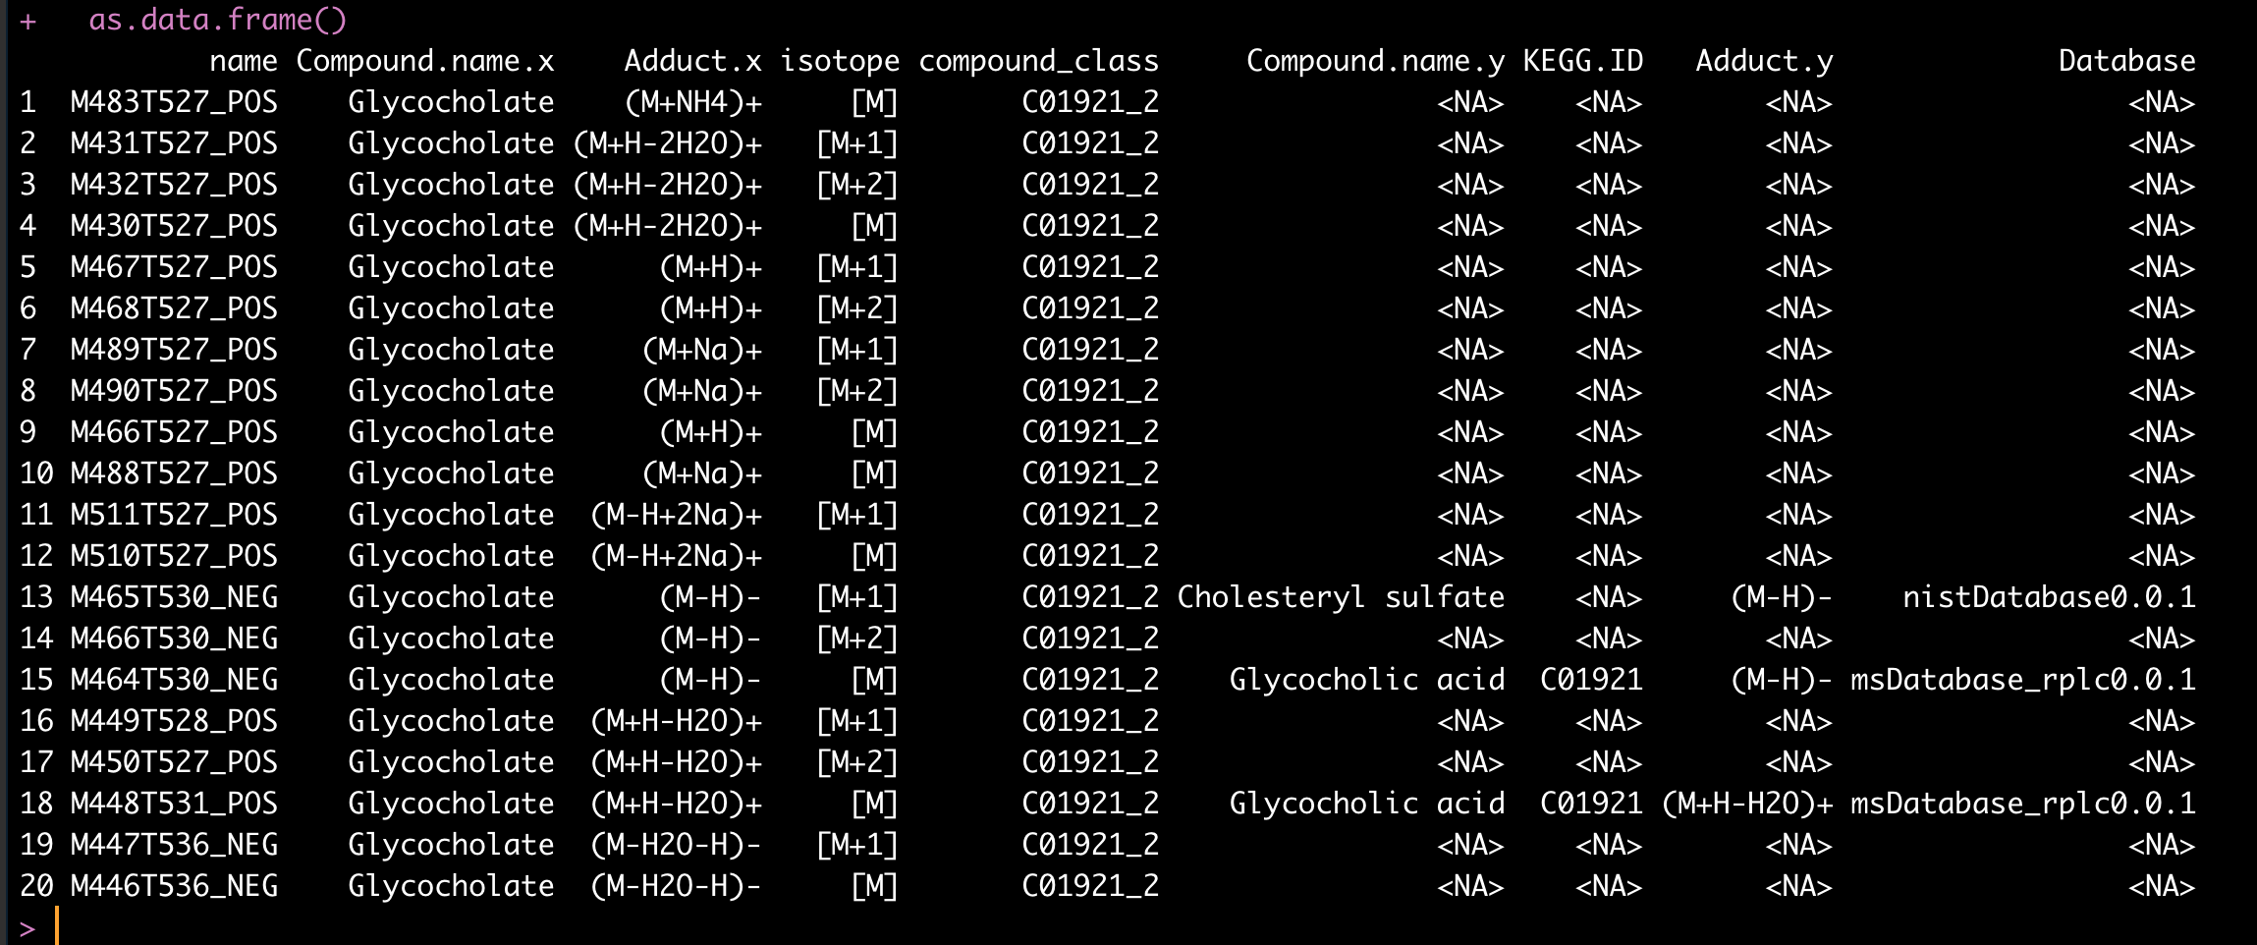
A example for compound class with score 200

Slide 10
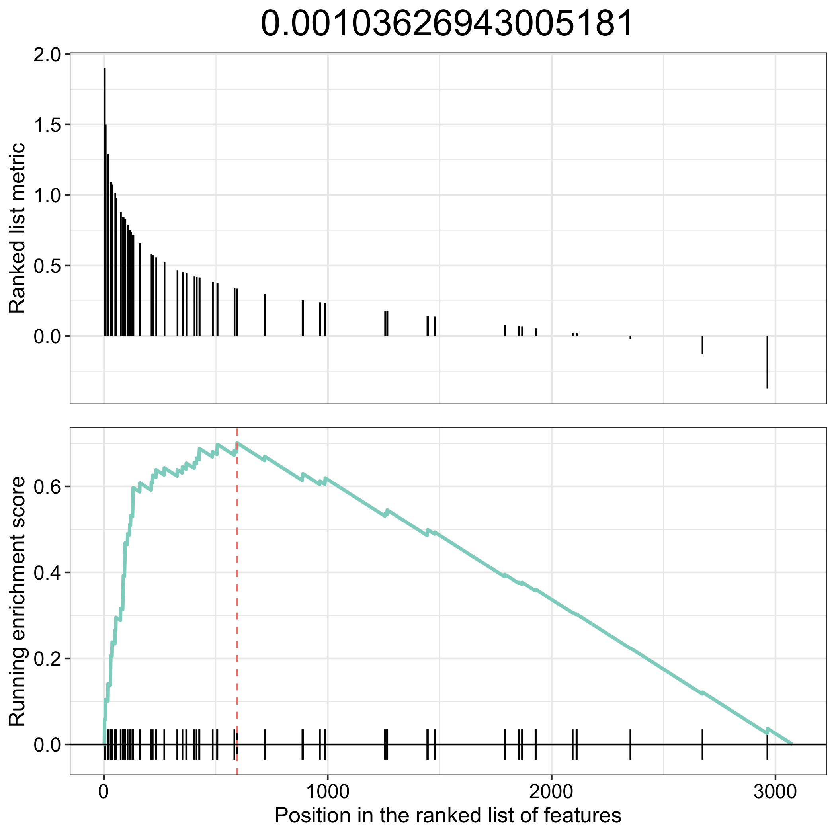
A example for MSEA
hsa00140
Steroid hormone biosynthesis

Slide 11
ACKNOWLEDGEMENT

Slide 12
Thanks for your attention!
Xiaotao Shen PhD
Stanford School of Medicine
Department of Genetics
shenxt@stanford.edu
@JasperShen1990
shenxt.me
github.com/jaspershen

